Slide 1
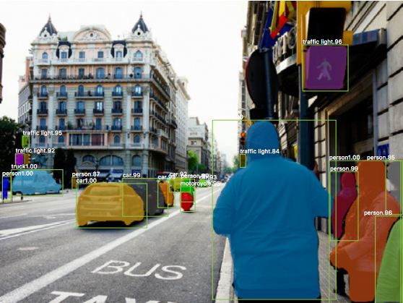
Instance Segmentation
Each instance of same object identified separately

Slide 2
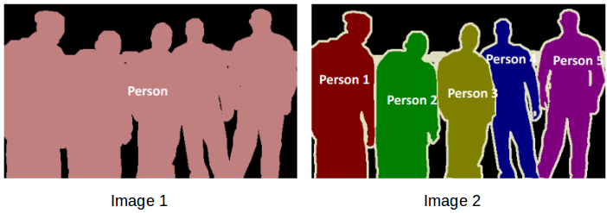
Semantic Segmentation
Instance Segmentation
Pixel classification at Class level
Pixel classification at Instance level

Slide 3
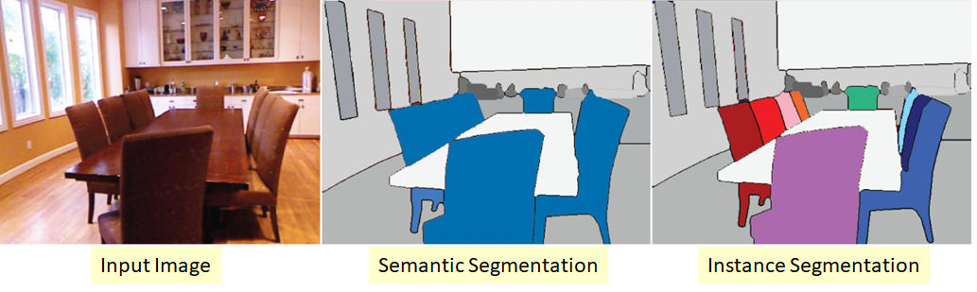
In Instance Segmentation, each object is identified separately

Slide 4

How to perform Instance Segmentation?

Slide 5
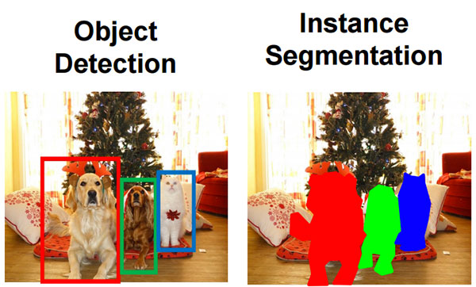
Instance Segmentation = Object Detection + Semantic Segmentation

Slide 6
Mask R-CNN
Combining Object Detection and Segmentation

Slide 7
Region Proposal Network
ROI
Pooling
Layer
FC Softmax
Dog
Feature Map
RoIs
Cat
CNN
Classification
Images
Feature Map
FC
x, y, w, h
FASTER R-CNN
Bounding Box

Slide 8
Region Proposal Network
ROI
Align
FC Softmax
Dog
Feature Map
RoIs
Cat
CNN
Classification
Images
Feature Map
FC
x, y, w, h
Bounding Box
Mask R-CNN
Replaces RoI Pooling layer with RoI Align, adds FCN for generating segmentation mask
FCN
Segmentation Mask

Slide 9
Region Proposal Network
ROI
Align
FC Softmax
Dog
Feature Map
RoIs
Cat
CNN
Classification
Images
Feature Map
FC
x, y, w, h
Bounding Box
Segmentation Mask Output
FCN output classifies each pixel in two classes i.e Background or Object (not background). Detector output will tell what exact object is there in that box.
FCN
Segmentation Mask

Slide 10
What is RoI Align layer?

Slide 11
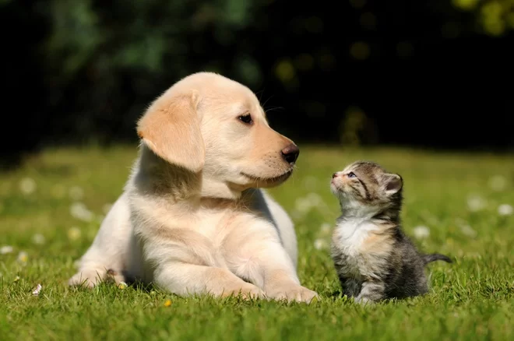
CNN
Feature Map
7 x 7 x 2048
224
CNN usually will produce a feature map which spatially is much smaller than original image. In the figure above, we started with a 224x224 image and got a feature map of 7x7 i.e. a reduction by a factor of 32 (224/7 = 32).
224

Slide 12
RoIs
(from RPN)
RoI coordinates from RPN will be in original image scale e.g 224x224
60
30, 160
170, 160
60
CNN
Feature Map
7 x 7 x 2048
50
224
150
100
30, 10
170, 10
224

Slide 13
RoIs
(from RPN)
Original image Feature Map
60
0.06 | 0.05 | 0.1 | 0.03 | 0.04 | 0.0 | 0.01
0.1 | 0.9 | 0.3 | 0.07 | 0.01 | 0.0 | 0.0
0.3 | 0.01 | 0.4 | 0.2 | 0.05 | 0.05 | 0.1
0.2 | 0.9 | 0.6 | 0.3 | 0.7 | 0.6 | 0.2
0.66 | 0.7 | 0.3 | 0.1 | 0.12 | 0.36 | 0.03
0.01 | 0.5 | 0.45 | 0.05 | 0.6 | 0.5 | 0.06
0.0 | 0.1 | 0.7 | 0.1 | 0.3 | 0.92 | 0.05
30, 160
170, 160
60
CNN
50
224
150
100
30, 10
170, 10
Feature map of whole image - 7x7x2048
224
How do we get RoI feature maps?

Slide 14
Building RoI Feature Map
30, 160
170, 160
RoI Coordinates | Divide coords by 32 | Convert to Int (Floor)
30,160 | 0.9, 5 | 0, 5
170, 160 | 5.3, 5 | 5, 5
30,10 | 0.9, 0.3 | 0, 0
170,10 | 5.3, 0.3 | 5, 0
224
150
30, 10
170, 10
Convert RoI coordinates from original image scale (224x224) to Feature map scale (7x7)
224
Let’s take one RoI to understand the steps

Slide 15
RoI Pooling Layer
Building RoI Feature Map
0.06 | 0.05 | 0.1 | 0.03 | 0.04 | 0.0 | 0.01
0.1 | 0.9 | 0.3 | 0.07 | 0.01 | 0.0 | 0.0
0.3 | 0.01 | 0.4 | 0.2 | 0.05 | 0.05 | 0.1
0.2 | 0.9 | 0.6 | 0.3 | 0.7 | 0.6 | 0.2
0.66 | 0.7 | 0.3 | 0.1 | 0.12 | 0.36 | 0.03
0.01 | 0.5 | 0.45 | 0.05 | 0.6 | 0.5 | 0.06
0.0 | 0.1 | 0.7 | 0.1 | 0.3 | 0.92 | 0.05
30, 160
170, 160
RoI Coordinates | Divide coords by 32 | Convert to Int (Floor)
30,160 | 0.9, 5 | 0, 5
170, 160 | 5.3, 5 | 5, 5
30,10 | 0.9, 0.3 | 0, 0
170,10 | 5.3, 0.3 | 5, 0
224
150
0.06 | 0.05 | 0.1 | 0.03 | 0.04 | 0.0 | 0.01
0.1 | 0.9 | 0.3 | 0.07 | 0.01 | 0.0 | 0.0
0.3 | 0.01 | 0.4 | 0.2 | 0.05 | 0.05 | 0.1
0.2 | 0.9 | 0.6 | 0.3 | 0.7 | 0.6 | 0.2
0.66 | 0.7 | 0.3 | 0.1 | 0.12 | 0.36 | 0.03
0.01 | 0.5 | 0.45 | 0.05 | 0.6 | 0.5 | 0.06
0.0 | 0.1 | 0.7 | 0.1 | 0.3 | 0.92 | 0.05
30, 10
170, 10
224
RoI Align Layer does not quantize RoI coordinates!
RoI Align Layer

Slide 16
How to do Max Pooling in RoI Align Layer?

Slide 17
RoI Align
0.06 | 0.05 | 0.1 | 0.03 | 0.04 | 0.0 | 0.01
0.1 | 0.9 | 0.3 | 0.07 | 0.01 | 0.0 | 0.0
0.3 | 0.01 | 0.4 | 0.2 | 0.05 | 0.05 | 0.1
0.2 | 0.9 | 0.6 | 0.3 | 0.7 | 0.6 | 0.2
0.66 | 0.7 | 0.3 | 0.1 | 0.12 | 0.36 | 0.03
0.01 | 0.5 | 0.45 | 0.05 | 0.6 | 0.5 | 0.06
0.0 | 0.1 | 0.7 | 0.1 | 0.3 | 0.92 | 0.05
1. Divide the RoI Area in desired feature map size e.g. 2x2
Feature extraction for RoI in RoI Align Layer

Slide 18
RoI Align
0.06 | 0.05 | 0.1 | 0.03 | 0.04 | 0.0 | 0.01
0.1 | 0.9 | 0.3 | 0.07 | 0.01 | 0.0 | 0.0
0.3 | 0.01 | 0.4 | 0.2 | 0.05 | 0.05 | 0.1
0.2 | 0.9 | 0.6 | 0.3 | 0.7 | 0.6 | 0.2
0.66 | 0.7 | 0.3 | 0.1 | 0.12 | 0.36 | 0.03
0.01 | 0.5 | 0.45 | 0.05 | 0.6 | 0.5 | 0.06
0.0 | 0.1 | 0.7 | 0.1 | 0.3 | 0.92 | 0.05
1. Divide the RoI Area in desired feature map size e.g. 2x2
2. Identify 4 (as per Mask RCNN paper) positions in each unit
Feature extraction for RoI in RoI Align Layer

Slide 19
RoI Align
0.06 | 0.05 | 0.1 | 0.03 | 0.04 | 0.0 | 0.01
0.1 | 0.9 | 0.3 | 0.07 | 0.01 | 0.0 | 0.0
0.3 | 0.01 | 0.4 | 0.2 | 0.05 | 0.05 | 0.1
0.2 | 0.9 | 0.6 | 0.3 | 0.7 | 0.6 | 0.2
0.66 | 0.7 | 0.3 | 0.1 | 0.12 | 0.36 | 0.03
0.01 | 0.5 | 0.45 | 0.05 | 0.6 | 0.5 | 0.06
0.0 | 0.1 | 0.7 | 0.1 | 0.3 | 0.92 | 0.05
1. Divide the RoI Area in desired feature map size e.g. 2x2
2. Identify 4 (as per Mask RCNN paper) positions in each unit
3. Calculate value for each position using bilinear interpolation.
Feature extraction for RoI in RoI Align Layer

Slide 20
RoI Align
0.06 | 0.05 | 0.1 | 0.03 | 0.04 | 0.0 | 0.01
0.1 | 0.9 | 0.3 | 0.07 | 0.01 | 0.0 | 0.0
0.3 | 0.01 | 0.4 | 0.2 | 0.05 | 0.05 | 0.1
0.2 | 0.9 | 0.6 | 0.3 | 0.7 | 0.6 | 0.2
0.66 | 0.7 | 0.3 | 0.1 | 0.12 | 0.36 | 0.03
0.01 | 0.5 | 0.45 | 0.05 | 0.6 | 0.5 | 0.06
0.0 | 0.1 | 0.7 | 0.1 | 0.3 | 0.92 | 0.05
1. Divide the RoI Area in desired feature map size e.g. 2x2
2. Identify 4 (as per Mask RCNN paper) positions in each unit
3. Calculate value for each position using bilinear interpolation.
Feature extraction for RoI in RoI Align Layer
4. MaxPool on resulting numbers

Slide 21
RoI Align
0.06 | 0.05 | 0.1 | 0.03 | 0.04 | 0.0 | 0.01
0.1 | 0.9 | 0.3 | 0.07 | 0.01 | 0.0 | 0.0
0.3 | 0.01 | 0.4 | 0.2 | 0.05 | 0.05 | 0.1
0.2 | 0.9 | 0.6 | 0.3 | 0.7 | 0.6 | 0.2
0.66 | 0.7 | 0.3 | 0.1 | 0.12 | 0.36 | 0.03
0.01 | 0.5 | 0.45 | 0.05 | 0.6 | 0.5 | 0.06
0.0 | 0.1 | 0.7 | 0.1 | 0.3 | 0.92 | 0.05
Max Pool
2x2 ROI Feature Map for the area
Feature extraction for RoI in RoI Align Layer

Slide 22
Bi-linear interpolation
80 | A | B | 110
Calculating value of A and B
(A - 80) / (110 - A) = 0.33
A = 90
80 | 90 | 100 | 110
(B - 80) / (110 - B) = 2.0
B = 100

Slide 23
Mask R-CNN
High Segmentation Accuracy
0.2 Secs to predict on One Image
5 fps

Slide 24
How do build Mask R-CNN?
TensorFlow Object Detection API
https://github.com/tensorflow/models/tree/master/research/object_detection

